Slide 1
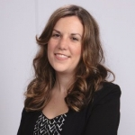
Diversity and Inclusion:
Building the Texas Disability History Collection
Society of American Archivists-Research Forum 2017
Samantha Dodd, Special Collections Archivist
Notes:
Please do try to attend the full day of the Forum if you can. In preparing your platform presentation, be sure to stress your problem statement, research method, results, findings, and, if relevant, further research
Acceptable file formats for your platform presentation include PDF, PowerPoint, and similar common formats. If you do not intend to use a presentation file, please bring a brief summary of your presentation

Slide 2
"Disability is everywhere in history, once you begin looking for it, but conspicuously absent in the histories we write.”
-Historian Douglas C. Baynton (2001)
[The Wheel-Chair Club of Denison Dam fish off of a pier]
Notes:
Problem Statement:
Approx. 54 million people in the US have some type of disability –Source whitehouse.gov
Some disabilities come from birth, some through accidents,, not all disabilities are seen with the naked eye
Anyone at any point in time can acquire a disability
Only minority group that anyone can at any point join-Dr. Sarah Rose
“People with disabilities are the largest minority in the country – they’re 20 percent of the population. We have only just begun to integrate this story into a larger picture of the Civil Rights era as well as U.S. history more broadly.”
--Dr. Sarah Rose, Director, Disability Minor Program at the University of Texas at Arlington
Disability Studies Minor
On-campus partners
Office for Students with Disabilities
Movin’ Mavs Adapted Sports and Recreation
UTA Libraries
College of Liberal Arts
Social Work BSW program
Off-campus partners
Coalition of Texans with Disabilities
Arlington Mayor’s Committee on People with Disabilities
Texas Governor’s Committee on People with Disabilities
Helping Restore Ability
UTARI
Emerging partners:
UT Austin’s Texas Center on Disability Studies
Per4Max

Slide 3
Research Method: Building an online collection
Collaboration and Usability Testing

Slide 4
UT Arlington &
the Office for Students with Disabilities
[Jim Hayes and Ronnie Eaton race in a dead heat]
Fort Worth Star-Telegram Collection. Series 6: Negatives
[Group photograph of the University of Texas at Arlington's 1975 Brazos Dorm Council.]
Notes:
UTA Timeline
1968 Sam Provence, John Dycus, and Joseph Rowe found the Handicap Club
1969 Texas Senate Bill 111 mandates that all public buildings and facilities become accessible and usable by physically handicapped and disabled citizens
1976 Jim Hayes establishes Freewheelers wheelchair basketball team; Sam Provence, John Dycus, Jim Hayes, and allies found the Arlington Handicapped Association
1978 UTA begins coordinating live-in attendants to allow students with severe mobility impairments to live on campus
1979 Handitran paratransit service established in Arlington
1986 Jim Hayes pushes his wheelchair from Austin to Arlington to raise money for the Arlington Handicapped Association
1991 Newly renamed Movin’ Mavs win the first of their four back-to-back national championships
2013 UTA Disability Studies Minor and Lady Movin’ Mavs wheelchair basketball team established
2016Lady Movin’ Mavs win first national championship
National Timeline
1968 Congress passes the Architectural Barriers Act
1973 Congress passes the first broad disability rights law: section 504 of the Rehabilitation Act of 1973
1990 Americans with Disabilities Act passed
2008 Congress passes the ADA Amendments Act
2016 over 3,000 people with cognitive disabilities remain institutionalized in Texas state schools

Slide 5
Site Development
Built in Drupal
HTML coding
Rich media
Structure and visual design
Notes:
Developing the site
Testing
Office of disability
Surveys and video entries
Metadata challenges
Site tour
Defining success
http://library.uta.edu/txdisabilityhistory/

Slide 6
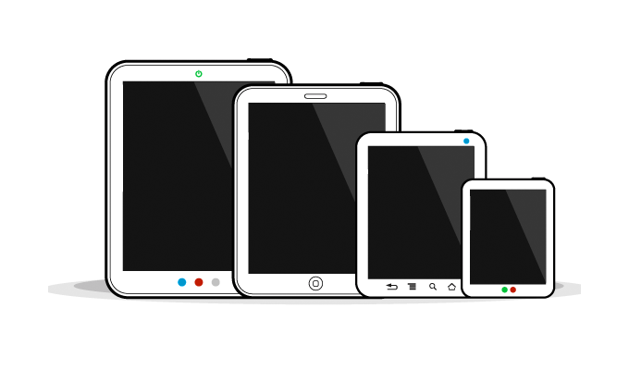
Web Usability Testing
Volunteers provided feedback
site modifications made in response
Tools used to test the site included:
HTML/CSS validation
Web Accessibility Evaluation Tool (WAVE)
Color contract (Contrast checker)
Colorblindness (wickline.org)
Tested on multitude of screen readers

Slide 7
Metadata challenges
Mashing existing taxonomy with new terms
Disability History Museum
Locally-created terms
Historical Context

Slide 8
Results
Texas Disability History Collection
Exhibit: Building a barrier free campus (Print and Digital)
DHAC

Slide 9
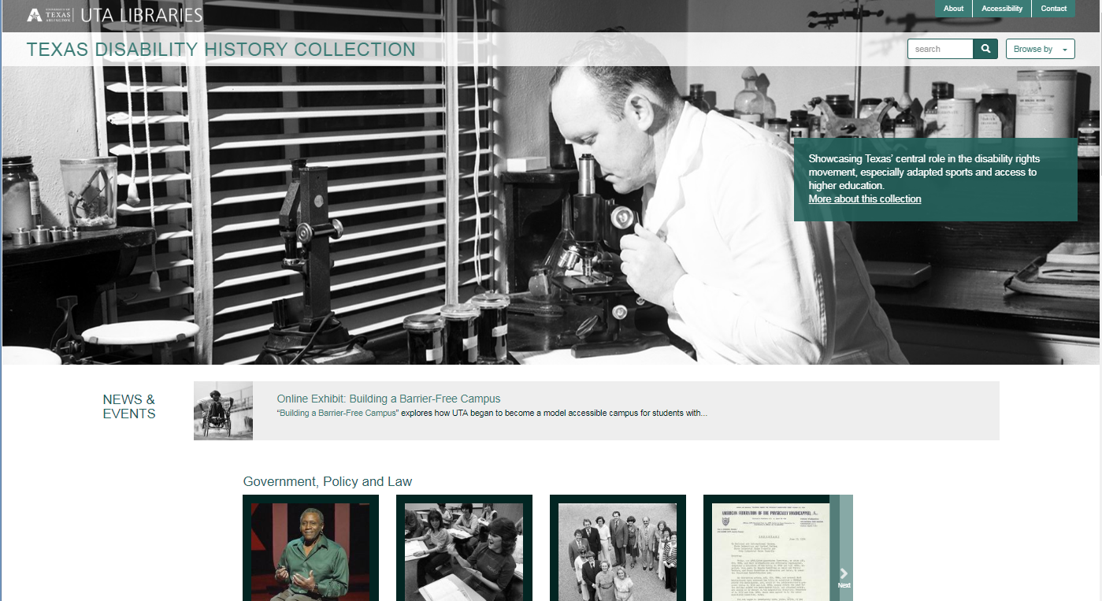
Notes:
Demo Web site

Slide 10
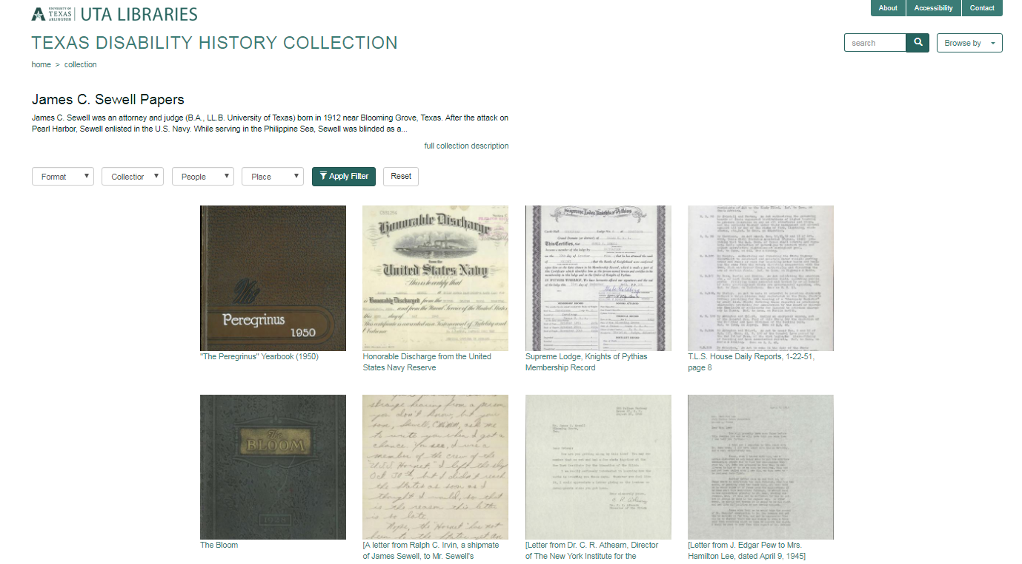

Slide 12
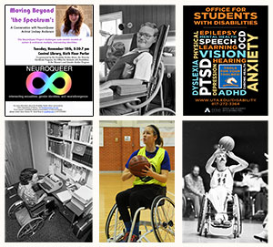
Additional Results
Exhibits and Consortium
Disabilities History Archives Consortium
Notes:
Print vs. Digital: Showcases other disability rights initiatives to come out of UTA, such as major non-profit Helping Restore Ability, public transit activism, local K-12 adapted sports programs, and the Arlington Mayor’s Committee on People with Disabilities.
How disabled UTA students and alumni helped to develop adapted sports in Texas and beyond
How the Handicapped Students Association and a wide range of allies pushed for full access to the college experience, including dorms, intramural sports, and honor societies
How UTA became a trendsetter in disability accessibility for universities in Texas and other states starting in the early 1970s
How disabled UTA alumni drove disability rights activism in the DFW Metroplex, from transportation access to accessible housing
“Building a Barrier-Free Campus” explores how UTA began to become a model accessible campus for students with disabilities starting in the mid-1960s—a time when disabled students had no right to attend K-12 schools or college. The exhibit covers:
The exhibit covers a broad timeline (mid-1960s to today) and introduces viewers to both UTA’s status as a leader in disability accessibility today and the multi-championship-winning Movin’ Mavs adapted sports program

Slide 13
Defining success
Awareness
Press
Requests for presentations
Funding
Interest at the Texas state government level
Use statistics
Notes:
Diversity Award | Society of American Archivists
Third most visited digital collection site

Slide 14
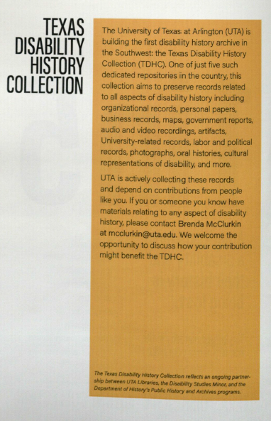
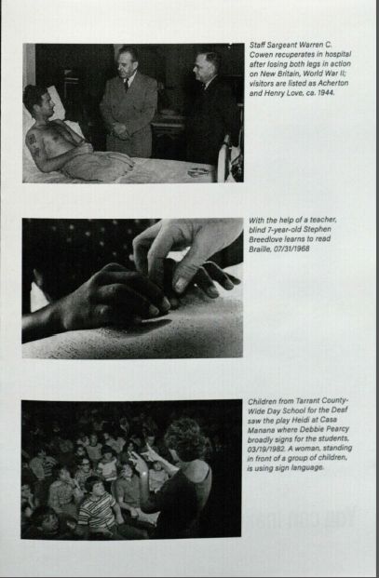
Room for improvement
Notes:
Going forward
-adding materials
-more usability studies
-additional commentary options
-reviewing bias/focus (i.e. brochure)

